Slide 1


You’re going to Hear Us ROAR in the Restroom!
Always flush after use
Keep the bathroom clean
Throw trash in the trashcan
Wash your hands
Respect others’ privacy
Turn off the water
Use time wisely
R
O
A
R

Slide 2
You’re going to Hear Us ROAR at Bus Dismissal!
Sit quietly in your assigned location
Keep items in your book bag
Use the restroom before dismissal
Keep hands and feet to yourself.
Be respectful to teachers. Stand quietly when your bus is called
Pay attention to the bus as they are called
Get on the right bus and off at the right location
R
O
A
R

Slide 3
You’re going to Hear Us ROAR In the Computer Lab!
Take care of the equipment
Work quietly
Respect others’ working
Use your time wisely
Complete assigned activities
Do not eat or drink
Clean your area
Respect equipment
Do well on your tests
Use appropriate websites
R
O
A
R

Slide 4
You’re going to Hear Us ROAR on the Bus!
Respect the bus driver
Be courteous to others
Use respectful language
Keep hands and feet to yourself
Stay in your seat
Use quiet voices
Keep the bus clean
Be at the bus stop on time
R
O
A
R

Slide 5
You’re going to Hear Us ROAR in the Gym!
Follow directions
Obey coaches
Remain in your personal space
Dress appropriately
Do your best
Participate
Show good sportsmanship
Play fair
R
O
A
R

Slide 6
You’re going to Hear Us ROAR in the Media Center!
Enter quietly and remain quiet
Take care of books
Check out appropriate level books
Return books on time
Follow directions
Wait quietly
Enjoy reading
Strive to increase your Lexile score
R
O
A
R

Slide 7
You’re going to Hear Us ROAR in the Hallway!
Walk on the right side of the hall
Keep hands and feet to yourself
Respect others’ work on the walls
Stay with your class
Use appropriate language
Respect others’ space
Respect others’ right to learn
Go directly to your destination
R
O
A
R

Slide 8
You’re going to Hear Us ROAR in the Cafeteria!
Keep food and drink in the cafeteria.
Respect lunchroom staff
Keep unwanted food on the tray.
Walk in the hallways
Use inside voices
Clean up behind yourself
Quietly wait in line
Follow directions from adults
Use good manners
Eat a well balanced meal
Try different foods
R
O
A
R

Slide 9
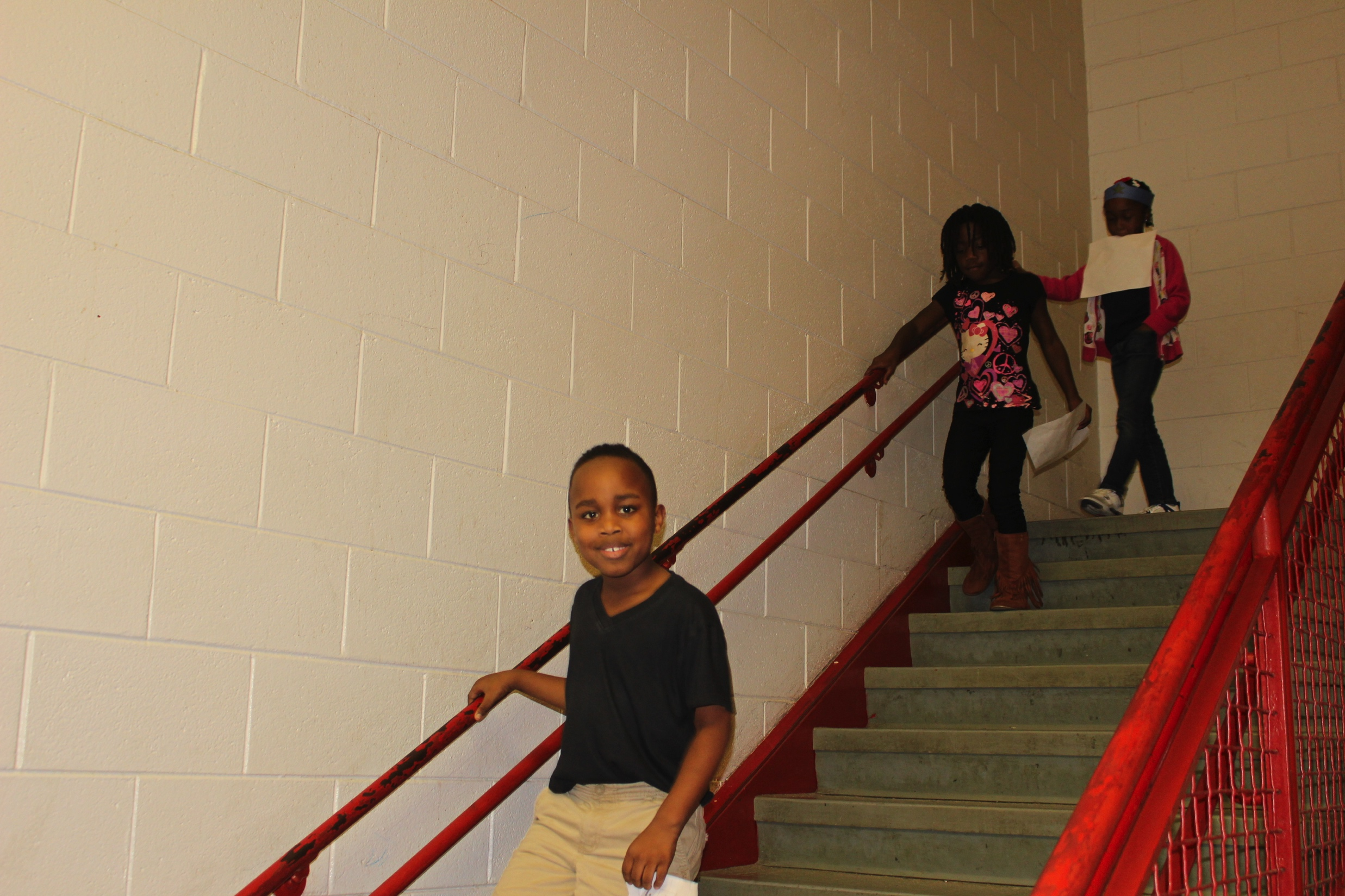
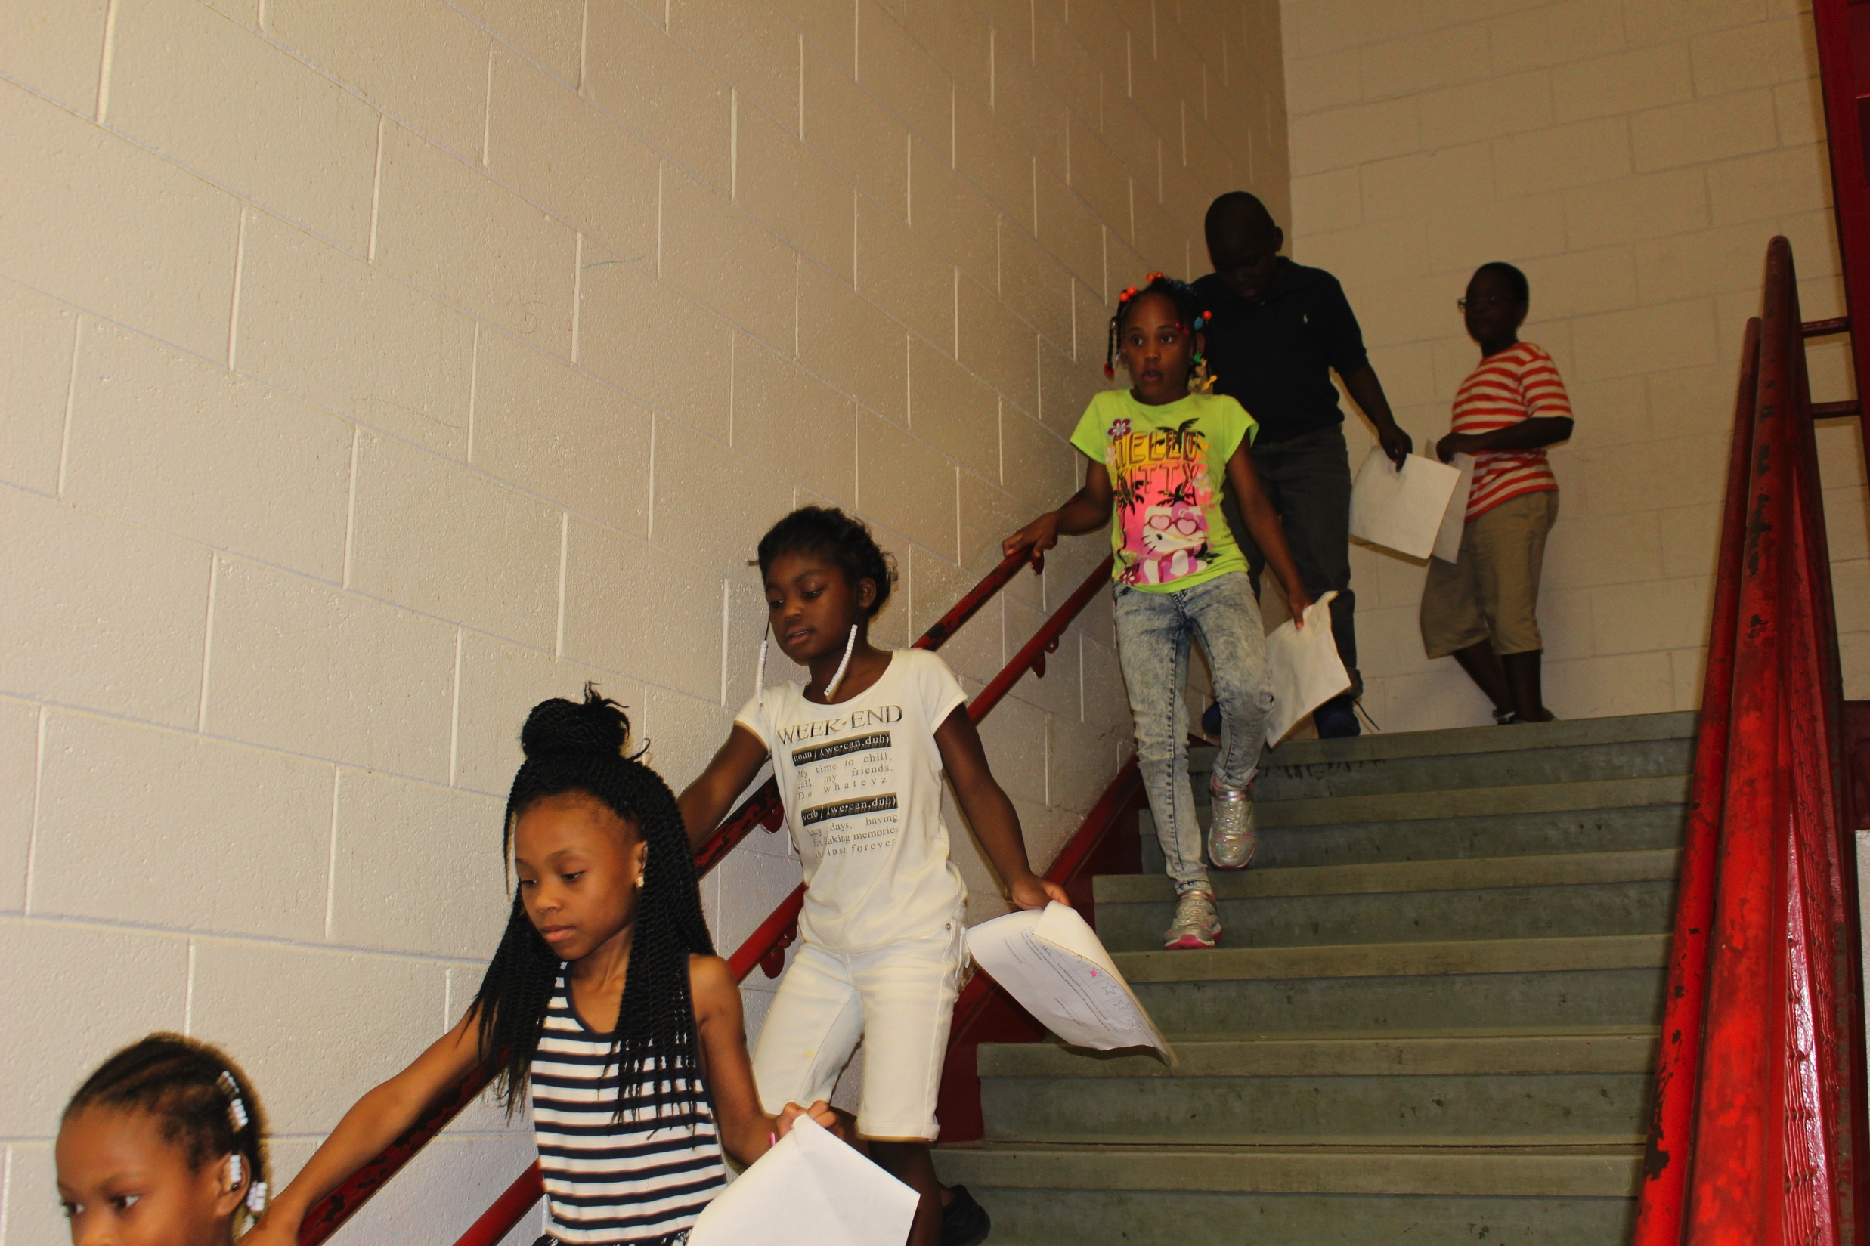
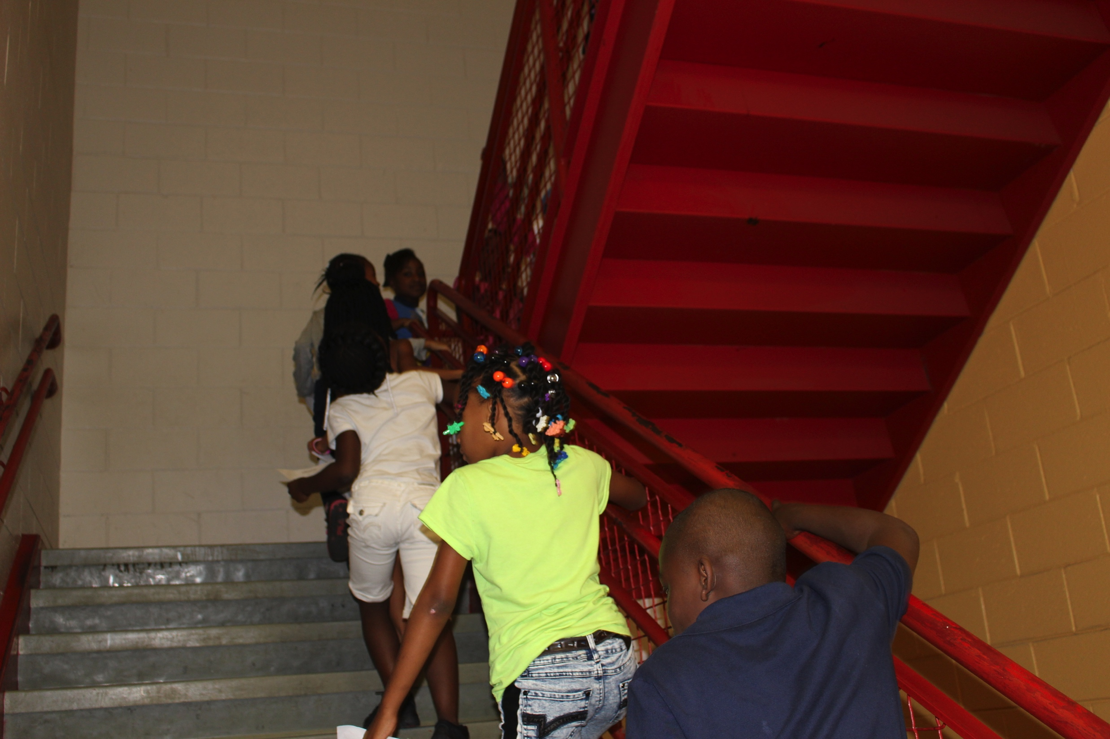
You’re going to Hear Us ROAR in the Stairwell!
Stop at each landing and wait for your teacher. Be respectful of other’s learning
Walk quietly up and down the stairs one at a time. Use the railing for safety.
Quietly wait in line
Follow directions from adults. Stay to the right side so others can pass.
Reach your final destination. Be careful on stairs.
R
O
A
R

